Slide 1
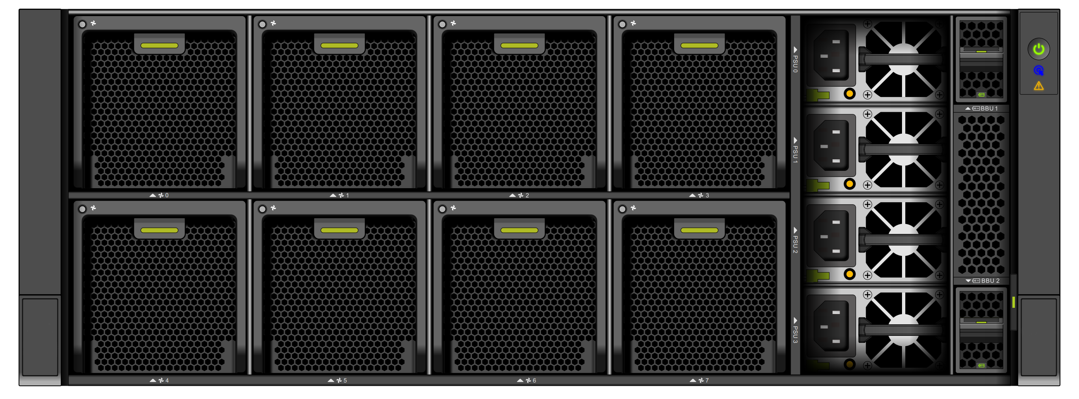
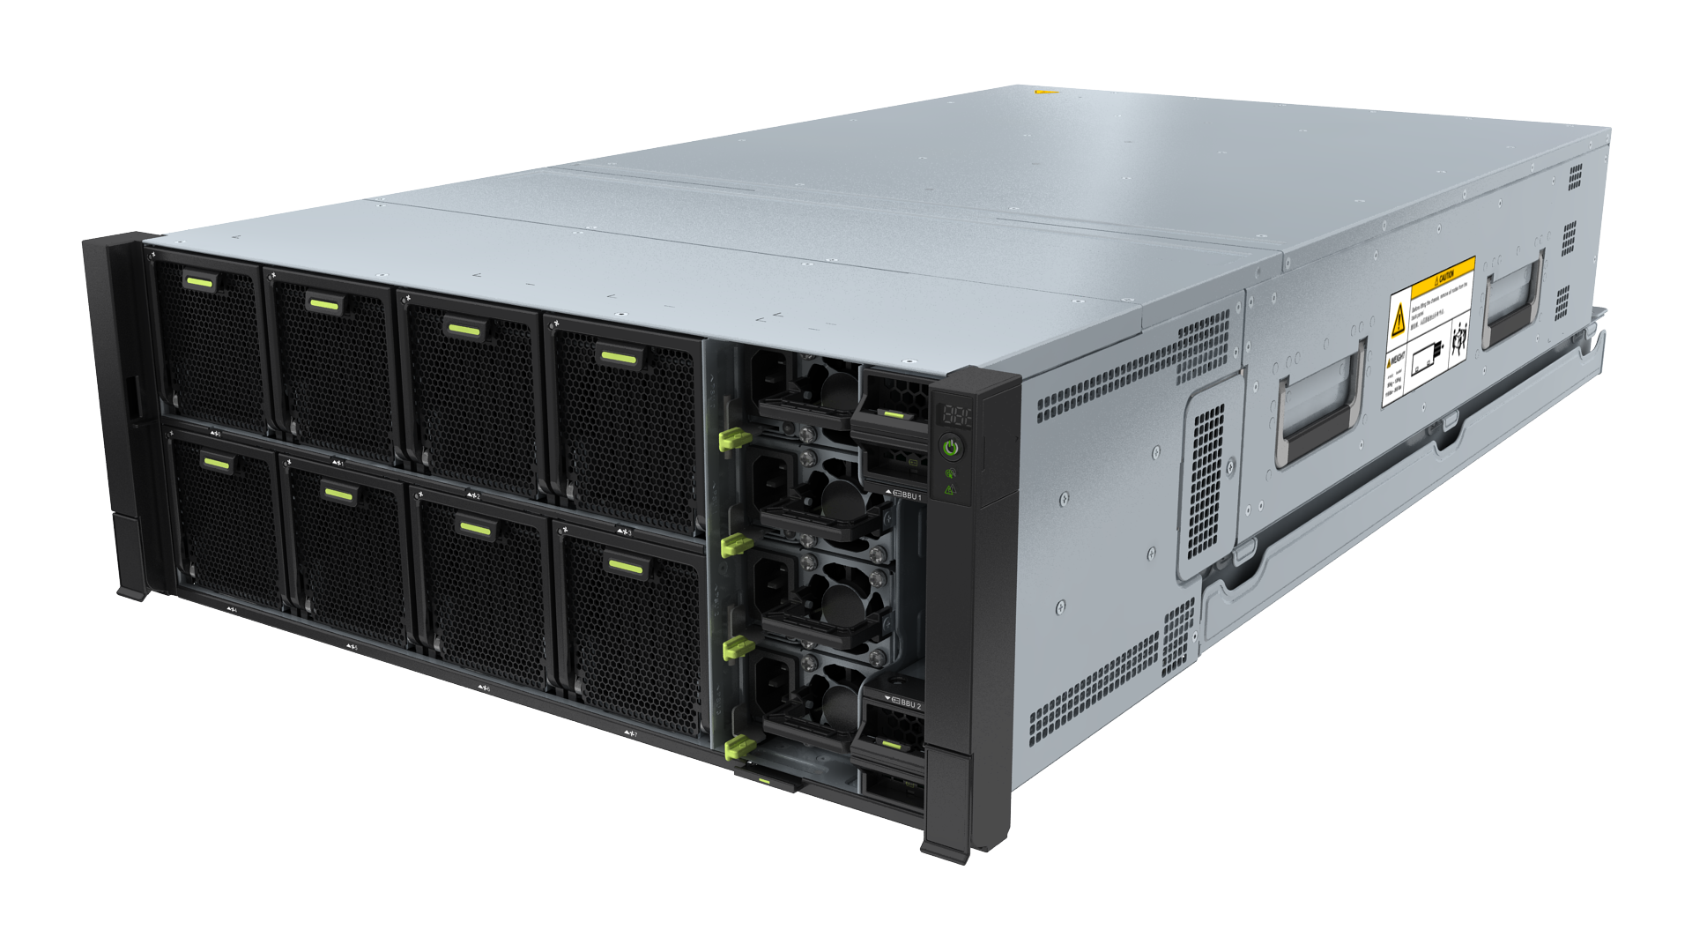
Introducing Openstor 2910
New Era of HCI+ Solution

Slide 2
SMEs IT Infrastructure Struggles
Long rollout period ≥ 3 months
Many O&M potential risks
Likely to lose data
No standard solution
1-month design period by multiple vendors
2-month procurement period
Hardware installation and basic service deployment and commissioning in batches
No unified O&M
Maintenance by multiple vendors
70% of customers do not use professional storage.
for new construction or information system reconstruction
On-site locating of
faulty component
Applying for fault rectification from the original manufacturer
60+ design solutions
Procurement in more than 5 batches
Onsite serial delivery,
requiring three kinds of skilled engineers
Slow and difficult data recovery
Separate procurement from multiple vendors
Low integration
Onsite assembly
Long engineering period
Different standards
Multiple device types
High maintenance costs
Decentralized management
Poor compatibility

Slide 3
SMEs Requirements
Integrated construction and
delivery
Easy O&M, easy-to-use
High data security and reliability
All-in-one device
High efficiency

Slide 4
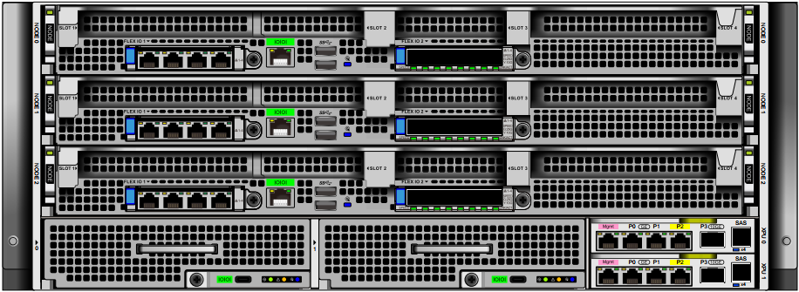
Introducing Openstor 2910
Highly Integrated, Highly Reliable, and Open Hardware Architecture
Hardware Specifications
System Architecture | 4 U integrated storage, compute, and network device 3 compute nodes + 2 storage nodes
Compute Node Type | 1 U compute board (supporting general standard compute boards) *
System Disk | Storage SAN boot, free of system disks
Network Type | 2-port GE/10GE/25GE card
Storage Processor | Multi-core Kunpeng processor
Max. Cache per Controller | 40 GB
Max. Number of SSDs | 110
Disk Type | SAS SSD, NL-SAS
Supported RAID Levels | RAID 5, RAID 6, and RAID-TP (tolerating the simultaneous failures of three disks)
Software Features
Virtualization | FusionCompute
Value-added Features | SmartAcceleration,SmartVirtualization, SmartMigration, SmartThin, SmartQoS, SmartQuota, SmartMulti-Tenant, SmartCompression, SmartErase HyperVault, HyperSnap, HyperReplication, HyperClone, HyperMetro, HyperCDP, HyperLock
Storage Management | DeviceManager, DME IQ
Front view
Rear view
High integration
integrates 10 U devices in 4 U space.
Notes:
10U设备：3个2U服务器+2个2U存储+2个1U 10GE交换机

Slide 5
Infrastructure as a service (IaaS), 4 U micro DC
Integrated deployment of hardware and software
Management
O&M
Application software
Application software
3 compute nodes + 1 dual-controller storage node
Unified management and O&M
Virtualization
container
VM
Compute
=
Storage
protocol
Compute
Compute
SAN
NAS
Storage
Storage
Compute
Storage
OpenStor 2910
Provides professional storage and enterprise-level SAN+NAS capabilities.
Data center CI appliance (cabinet-type)

Slide 6
Total Optimization: Space, energy consumption, delivery, O&M, and Investment.
Compact
from 12U to 4U (66.7% saving)
45.2% less power
Simple O&M
Start time from days to minutes
No-Cabling
Reduced investment
TCO reduced by +20%.
Traditional solution
OpenStor 2910
Service switch
Service host
Internal switch
Management Switch
Compute node
Disks Drawer
Storage controllers
Controller A
Controller B
Storage
Unified management platform
Data line
Management line
At least 11 power cables, 10 service lines, and 7 management cables

Slide 7
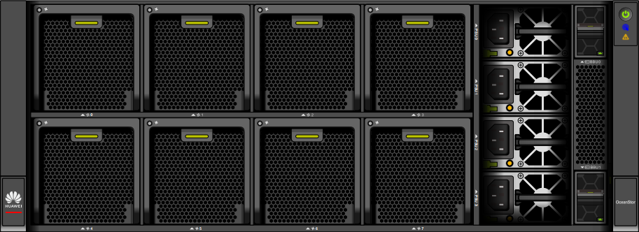
Branch Office Solution
Integrated management of storage, computing, and network devices
Device Manager:
single-node integrated management
Virtual Resource Management
branch
Site Management
branch
Alarm management
branch
Unified configuration
Partner tenant managed service
branch
eService:
cloud-based O&M
DME:
Unified management and O&M of central and branch offices
Performance statistics
Mobile app O&M

Slide 8
Integrated design for small- and medium-sized IC enterprises
Joint Solutions with FusionCompute Ecosystem
Physical, chemical, biological lab examination
Supermarket chain
Internship and practice scenarios
Enterprise document cloud
Education
Large enterprise
Manufacturing
Integration of district elementary education schools
Edge sites of central control stations
Core services of small- and medium-sized hospitals
Electric power
Healthcare
Smart campus management
Application emergency takeover
Horizontal solutions
Branch/Center
ISV application appliance

Slide 9
About Openstor
Innovation and Reliability without Compromise
On the stage of innovation and reliability, OpenStor stands for pioneering advanced solutions that embrace growth and transform challenges into opportunities.
20+ Years
Since late '90s
HA for SMEs
Specialized in Business Continuity
100% Proofed
Trusted by 100+ Customers

Slide 10
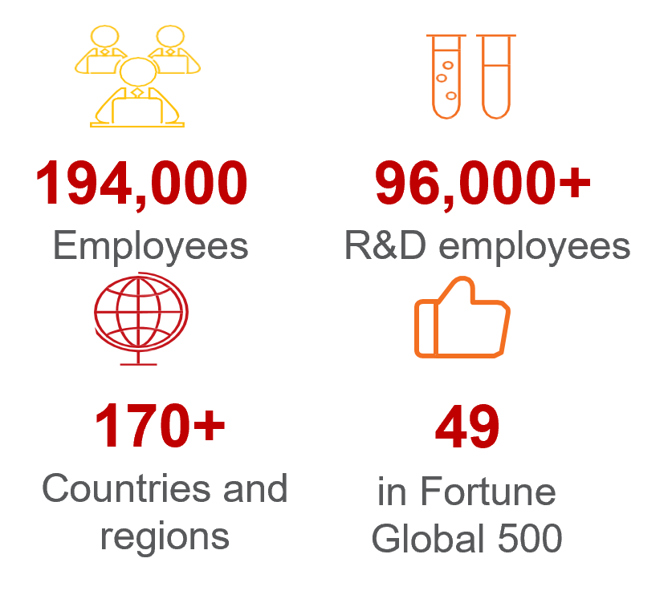
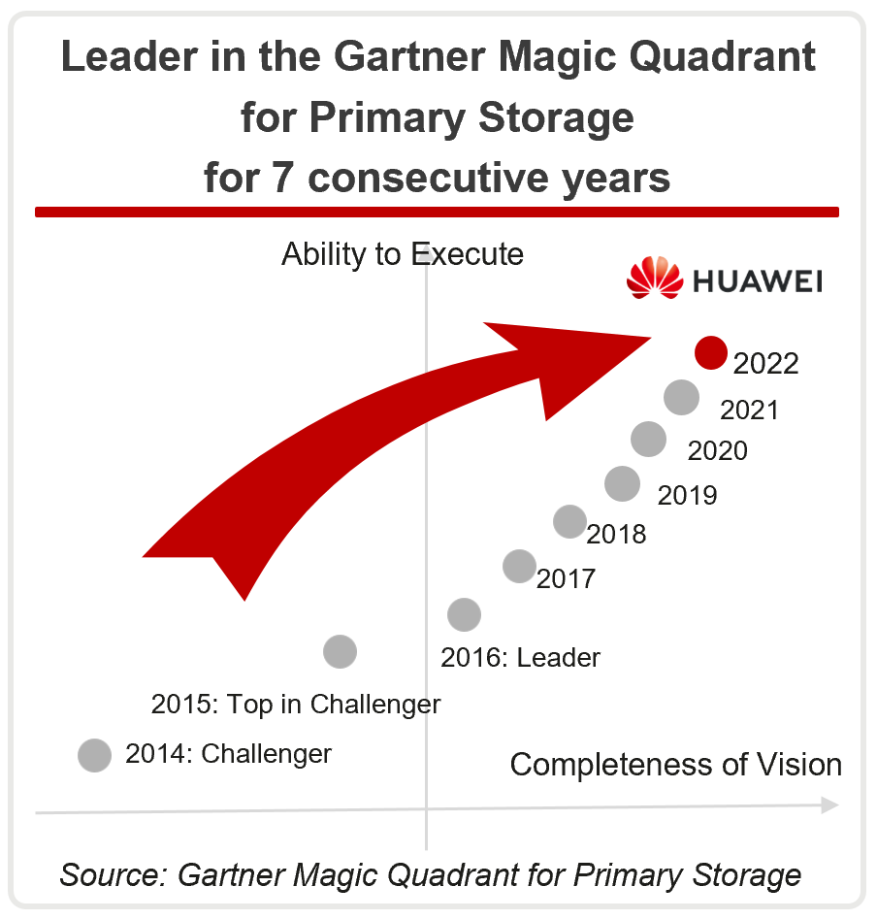
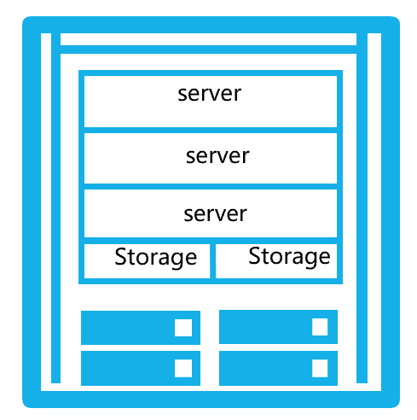
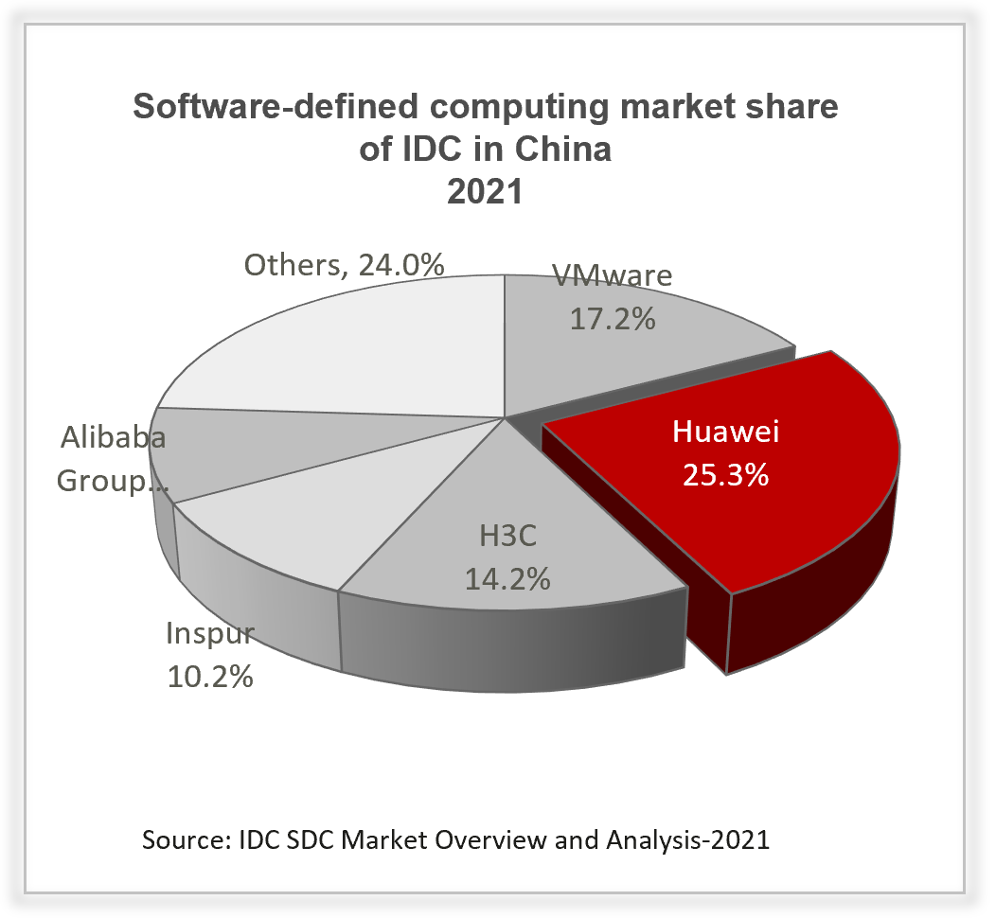
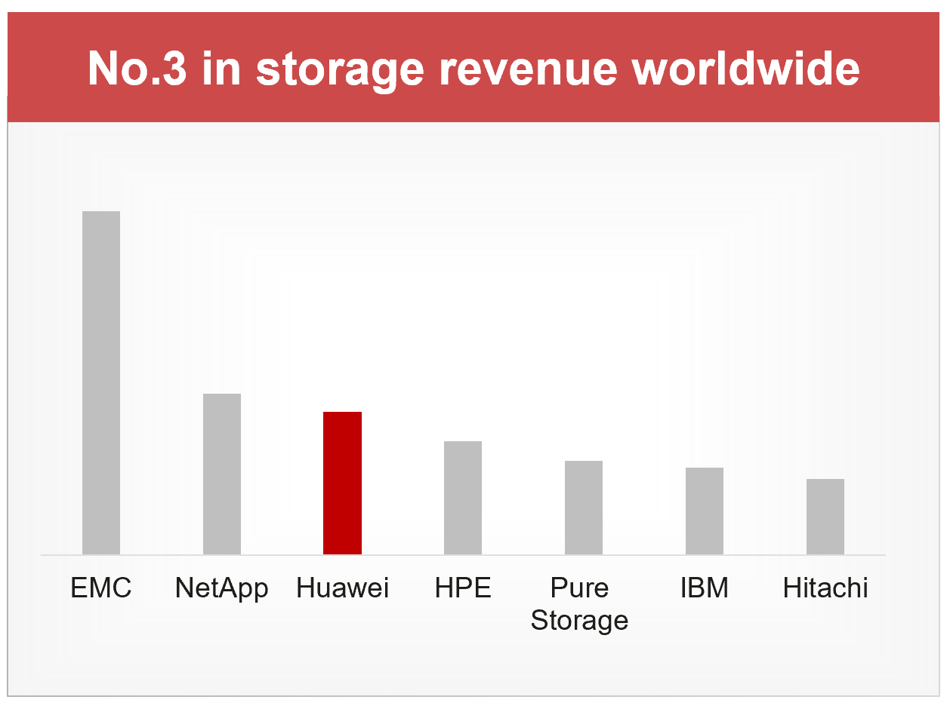
Partnership with Huawei Design-In Program
About
OpenStor 2910
Powered By Huawei
Key technologies:
FusionCompute Virtualization
OceanStor OS Data Storage

